Slide 1
Results
 | logreg | RF | model3
Accuracy
logloss
Fairlearn results

Slide 2
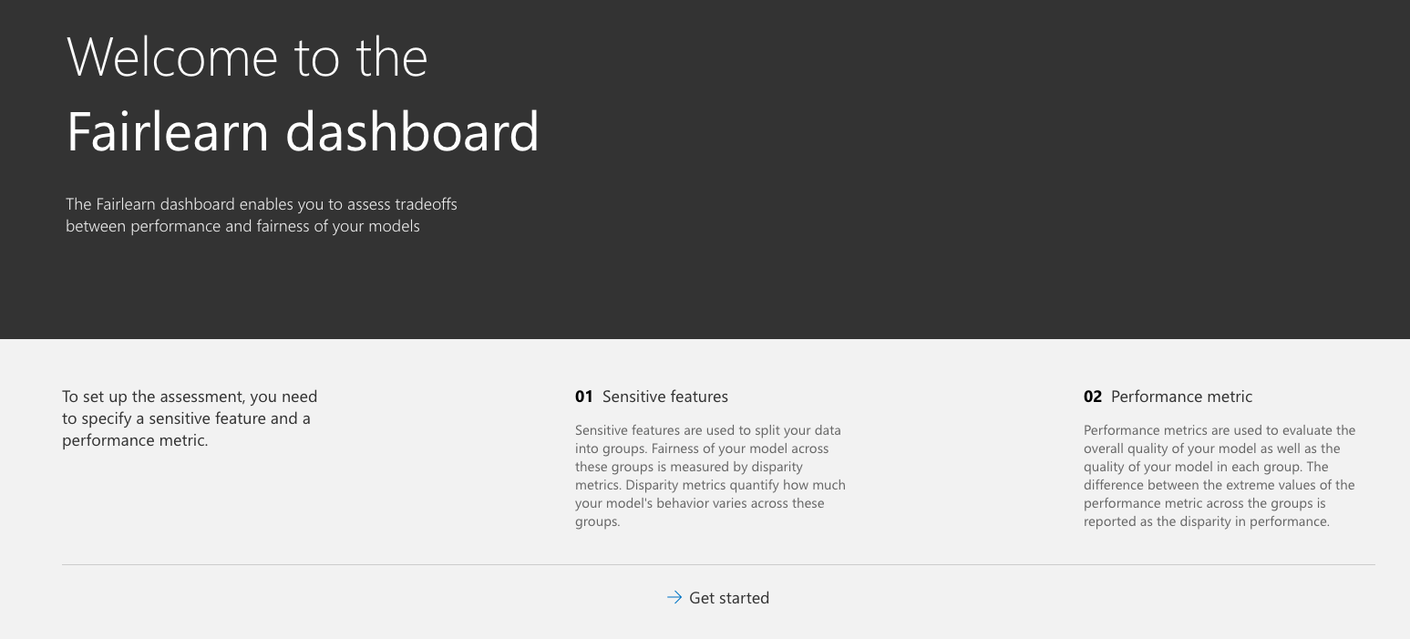
Fairlearn Dashboard
2.

Slide 3
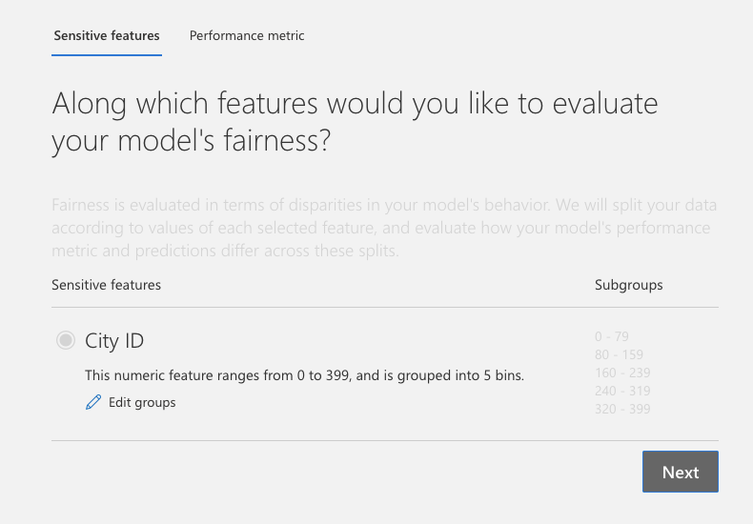
Sensitive Features

Slide 4
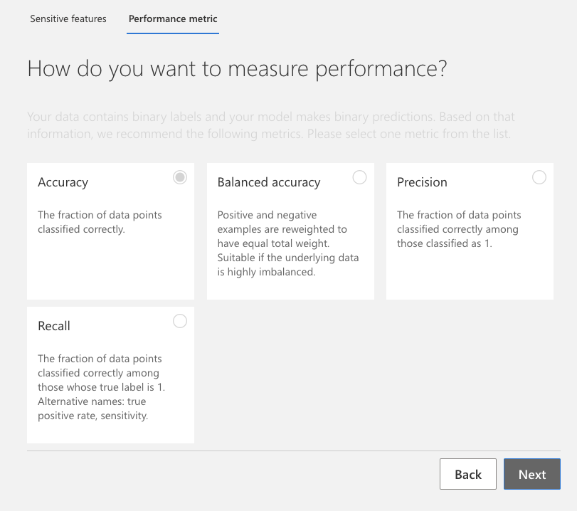
2. Performance Metrics

Slide 5
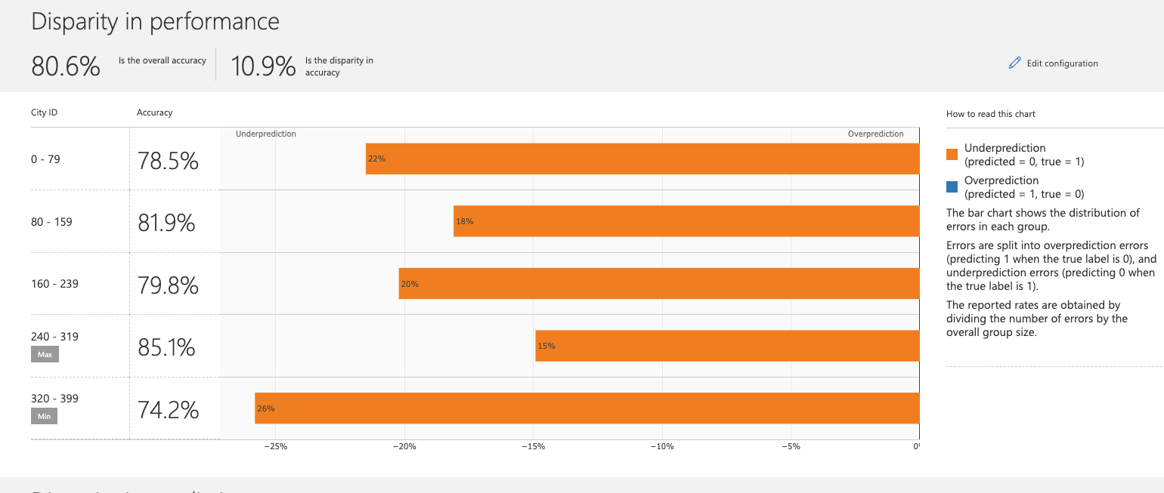
Results: high disparity in accuracy

